Slide 1
Project Management
3
Kendall & Kendall Systems Analysis and Design, 9e
Notes:
1

Slide 2
Learning Objectives
Understand how projects are initiated and selected, define a business problem, and determine the feasibility of a proposed project.
Evaluate hardware and software and the way it supports human interactions with technology.
Forecast and analyze tangible and intangible costs and benefits.
Manage a project by preparing a budget, creating a work breakdown structure, scheduling activities, and controlling the schedule and costs.
Build and manage a project team
Professionally write and present an effective systems proposal, concentrating on both content and design

Slide 3
Project Management Fundamentals
Project initiation
Determining project feasibility
Activity planning and control
Project scheduling
Managing systems analysis team members
Notes:
Project initiation—begins with problems or with opportunities for improvement in a business as the organization adapts to change.
Determining project feasibility—need to work with decision makers to determine if it is feasible.
Project scheduling—project activities are scheduled through the use of tools such as Gantt charts and PERT diagrams.
Planning and managing activities and team members—part of assuring the productivity of systems analysis team members is effectively managing scheduled activities.

Slide 4
Major Topics
Project initiation
Determining feasibility
Determining resources
Activity planning and control
Gantt charts
PERT diagrams
Managing analysis and design activities
The agile approach

Slide 5
Project Initiation
Problems in the organization
Problems that lend themselves to systems solutions
Opportunities for improvement
Caused through upgrading, altering, or installing new systems
Notes:
Both problems and opportunities can arise as the organization adapts to and copes with natural, evolutionary change.

Slide 6
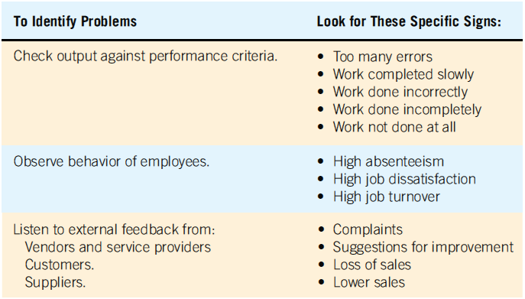
Checking Output, Observing Employee Behavior, and Listening to Feedback Are All Ways to Help the Analyst Pinpoint Systems Problems and Opportunities

Slide 7
Problem Definition
Problem statement
Paragraph or two stating the problem or opportunity
Issues
Independent pieces pertaining to the problem or opportunity
Objectives
Goals that match the issues point-by-point
Requirements
The things that must be accomplished along with the possible solutions, and constraints, that limit the development of the system
Use the problem definition to create a preliminary test plan
Notes:
Issues are the current situation, objectives are the desired situation.
Requirements may include security, usability, government requirements and so on.
Constraints might be budget restrictions or time limitations.

Slide 8
Selection Of Projects
Backing from management
Appropriate timing of project commitment
Possibility of improving attainment of organizational goals
Practical in terms of resources for the system analyst and organization
Worthwhile project compared with other ways the organization could invest resources
Notes:
Backing from management—absolutely nothing can be accomplished without the endorsement of the people who eventually will foot the bill.
Appropriate timing of project commitment—can a time commitment be made for installation of new systems or improvement to existing ones.
Possibility of improving attainment of organizational goals—the project should put the organization on target, not deter it from its goals.
Practical in terms of resources for the system analyst and organization—is there expertise and resources to carry out the project.
Worthwhile project compared with other ways the organization could invest resources—when a business commits to one project it is committing resources that are unavailable for other projects.

Slide 9
Selection of Projects: Improving Attainment of Organizational Goals
Improving corporate profits
Supporting the competitive strategy of the organization
Improving cooperation with vendors and partners
Improving internal operations support
Improving internal decision support so that decisions are more effective
Improving customer service
Increasing employee morale

Slide 10
Defining Objectives
Many possible objectives exist including:
Speeding up a process
Streamlining a process
Combining processes
Reducing errors in input
Reducing redundant storage
Reducing redundant output
Improving system and subsystem integration
Notes:
Improvements to systems can be defined as changes that will result in incremental but worthwhile benefits.

Slide 11
Determining Feasibility
Defining objectives
Determining resources
Operationally
Technically
Economically
Notes:
The feasibility study must be highly time compressed, encompassing several activities in a short span of time.

Slide 12
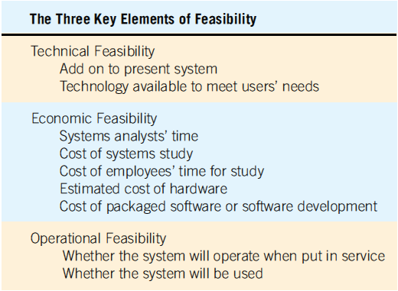
The Three Key Elements of Feasibility Include Technical, Economic, and Operational Feasibility
Notes:
A project must be feasible in all three ways to merit further development.

Slide 13
Technical Feasibility
Can current technical resources be upgraded or added to in a manner that fulfills the request under consideration?
If not, is there technology in existence that meets the specifications?
Notes:
Sometimes add-ons are costly and not worthwhile, because they meet needs inefficiently.

Slide 14
Economic Feasibility
Economic feasibility determines whether value of the investment exceeds the time and cost
Includes:
Analyst and analyst team time
Business employee time
Hardware
Software
Software development
Notes:
If short-term costs are not overshadowed by long-term gains or produce no immediate reduction in operating costs, the system is not economically feasible.

Slide 15
Operational Feasibility
Operational feasibility determines if the human resources are available to operate the system once it has been installed
Users that do not want a new system may prevent it from becoming operationally feasible
Notes:
If users are satisfied with current system resistance to implementing a new system will be strong.
If users are dissatisfied with the current system and have expressed a need for change chances are that the new system will be used.

Slide 16
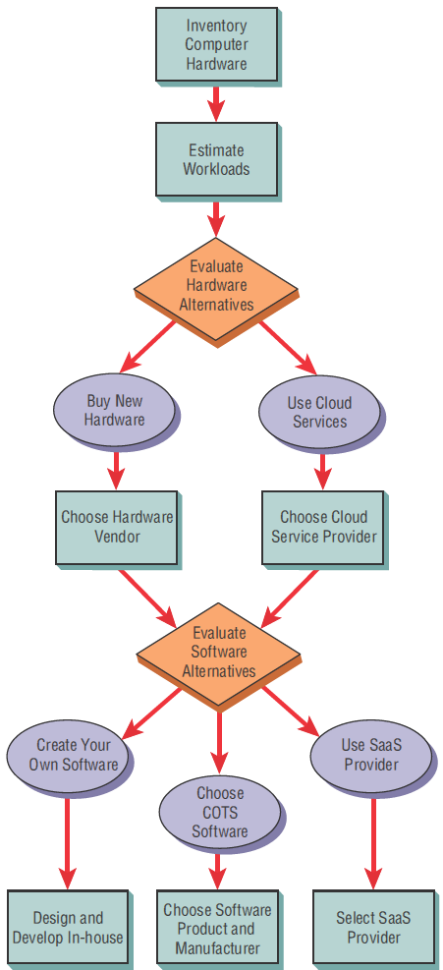
Steps in Choosing Hardware and Software

Slide 17
Acquisition of Computer Equipment
Purchasing
Using Cloud Services
Notes:
Influential factors:
Initial versus long-term costs.
Can capital afford to be tied up in computer equipment.
Should the business have full control of and responsibility for the computer equipment.

Slide 18
Available cloud services
Available cloud services may include:
Web hosting
Email hosting
Application hosting
Backup
Storage and processing of databases
Archiving
Ecommerce

Slide 19
Three Main Categories of Cloud Computing
Software as a Service (SaaS) third party hosts application
Infrastructure as a Service (IaaS) virtualized computing resources over the internet (data center)
Platform as a Service (PaaS) delivers hardware and software tools – usually those needed for application development

Slide 20
Benefits of Cloud Computing
Less time spent maintaining legacy systems
May be simpler to acquire IT services
Scalable applications that can grow by adding more cloud resources
Consistency across multiple platforms
Capital is not tied up

Slide 21
Drawbacks of Cloud Computing
Loss of control of data stored in the cloud
Potential security threats to data that is not stored on premises
Reliability of the Internet as a platform

Slide 22
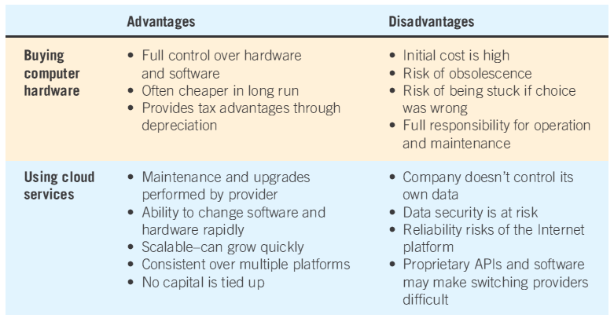
Purchasing or Using Cloud Services Advantages and Disadvantages
Notes:
Main determinants—projected life of the system.
As systems become smaller, more powerful, less expensive, and distributed systems become increasingly popular, more businesses are deciding to purchase equipment.

Slide 23
Evaluating Vendor Support
Hardware support
Software support
Installation and training support
Maintenance support
Notes:
Peruse the support services documents accompanying the purchase or lease of equipment and remember to involve appropriate legal staff before signing contracts for equipment or services.

Slide 24
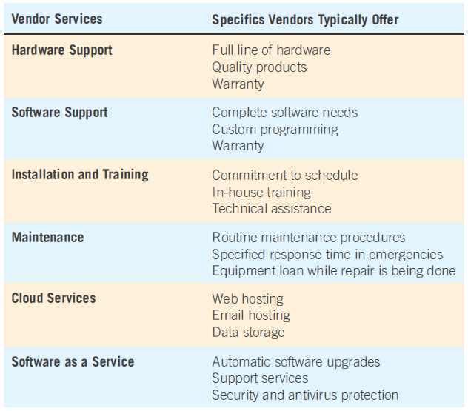
Guidelines for Vendor Selection

Slide 25
BYOD and BYOT
BYOD: Bring your own device
BYOT: Bring your own technology
Employee uses their own device access corporate networks, data, and services remotely

Slide 26
Benefits of BYOD and BYOT
Building employee morale
Potential for lowering the initial cost hardware purchase

Slide 27
Drawbacks of BYOD and BYOT
Security risks posed by untrained users
Loss of the device
Theft of the device and its data
Unauthorized access to corporate networks using personal mobile devices

Slide 28
Software Alternatives
Created custom software
Purchased as COTS (commercial off-the-shelf) software
Provided by an software as a service (SaaS)
Notes:
It is imperative to complete a human information requirements analysis of the users and the systems they use first.

Slide 29
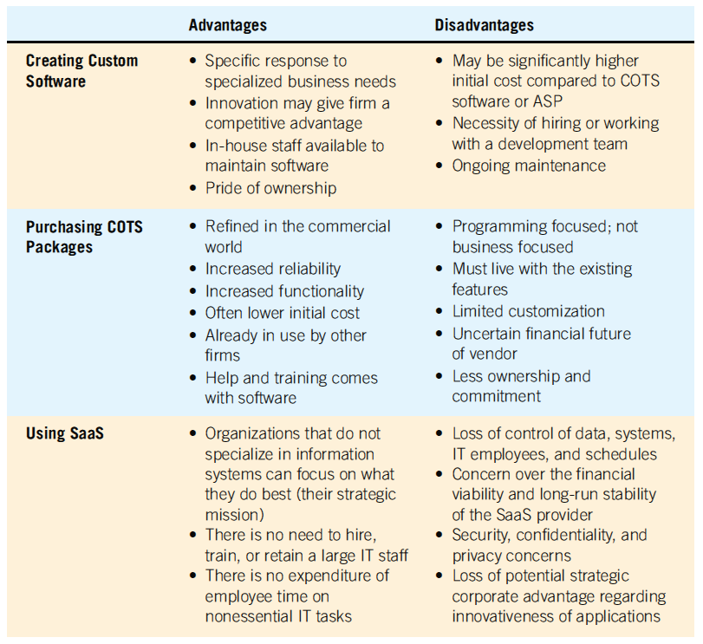
Software Alternatives

Slide 30
Software Evaluation
Performance effectiveness – value etc
Performance efficiency – competence
Ease of use
Flexibility
Quality of documentation
Manufacturer support

Slide 31
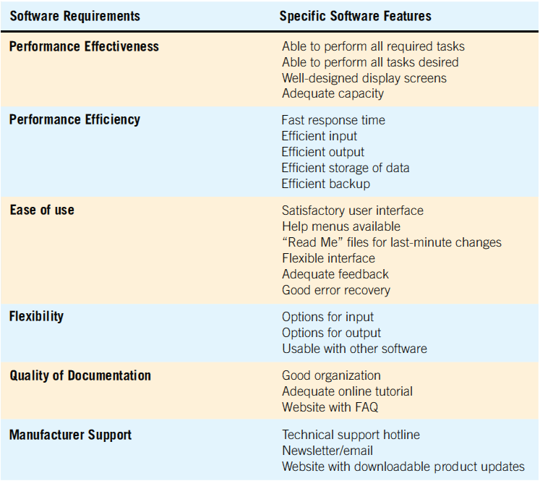
Guidelines for Evaluating Software (Figure 3.9)
Notes:
Evaluate packaged software based on a demonstration with test data from the business considering it and an examination of accompanying documentation.

Slide 32
Identifying Benefits and Costs
Tangible benefits are advantages measurable in dollars through the use of the information system
Intangible benefits are difficult to measure
Tangible costs are accurately projected by the systems analyst and accounting personnel
Intangible costs are difficult to estimate and may not be known
Notes:
Both tangible and intangible cost must be taken into account when systems are considered.

Slide 33
Tangible Benefits
Advantages measurable in dollars that accrue to the organization through the use of the information system
Examples:
Increase in the speed of processing
Access to otherwise inaccessible information
Access to information on a more timely basis
The advantage of the computer’s superior calculating power
Decreases in the amount of employee time needed to complete specific tasks
Notes:
Tangible benefits can be measured in terms of dollars, resources, or time saved.

Slide 34
Intangible Benefits
Intangible benefits are benefits from use of the information system that are difficult to measure
Examples:
Improving the decision-making process
Enhancing accuracy
Becoming more competitive in customer service
Maintaining a good business image
Increasing job satisfaction
Notes:
Both tangible and intangible benefits must be discussed in the proposal, both will allow decision makers to make a well-informed decision about the proposed system.

Slide 35
Tangible Costs
Those that can be accurately projected by systems analysts and the business’ accounting personnel
Examples:
Cost of equipment
Cost of resources
Cost of systems analysts’ time
Cost of programmers’ time
Employees’ salaries
Notes:
These costs are well established and are the costs that require a cash outlay of the business.

Slide 36
Intangible Costs
Those that are difficult to estimate and may not be known
Examples:
Losing a competitive edge
Losing the reputation of being first
Declining company image
Ineffective decision making
Notes:
It is generally not possible accurately to project a dollar amount for intangible costs.

Slide 37
Comparing Costs and Benefits
Break-even analysis
Payback
Cash-flow analysis
Present value analysis
Notes:
All these techniques provide straightforward ways of yielding information to decision makers about the worthiness of the proposed system.

Slide 38
Break-Even Analysis
The point at which the total cost of the current system and the proposed system intersect
Useful when a business is growing and volume is a key variable in costs
Advantage:
Can determine how long it will take for the benefits of the system to pay back the costs of developing it
Notes:
Total costs = costs that recur during operation of the system + developmental costs that occur only once

Slide 39
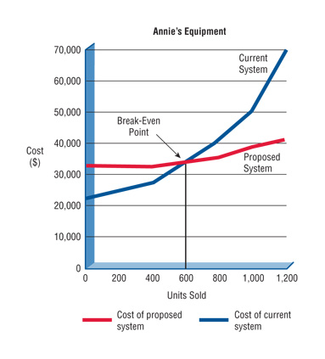
Break-Even Analysis

Slide 40
Cash-Flow Analysis
Examines the direction, size, and pattern of cash flow that is associated with the proposed information system
Determines when cash outlays and revenues will occur for both; not only for the initial purchase, but over the life of the information system
Notes:
Cash-flow analysis is used to determine when a company will begin to make a profit and when it will be “out of the red.”

Slide 41
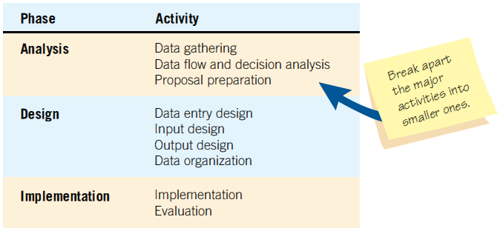
Beginning to Plan a Project by Breaking it into Three Major Activities

Slide 42
Project Scheduling
Gantt Charts
Simple
Lends itself to end user communication
Drawn to scale
PERT (program evaluation and review technique) diagrams
Useful when activities can be done in parallel

Slide 43
Using a Two-Dimensional Gantt Chart for Planning Activities that Can Be Accomplished in Parallel

Slide 44
A Completed PERT Diagram for the Analysis Phase of a Systems Project

Slide 45
PERT Diagram Advantages
Easy identification of the order of precedence
Easy identification of the critical path and thus critical activities
Easy determination of slack time

Slide 46
Managing the Team Project
Team management
Assembling a team
Team communication strategies
Project productivity goals
Team member motivation

Slide 47
Assembling a Team
Shared value of team work
Good work ethic
Honesty
Competency
Readiness to take on leadership based on expertise
Motivation
Enthusiasm for the project
Trust of teammates
Notes:
Experience—this could mean code is developed five times faster.
Motivation—select good people at the outset.
Enthusiasm—not only enthusiasm, but imagination and the ability to communicate with different kinds of people.
Trust—people may have different work styles, but they all need to agree to work together toward a common goal.

Slide 48
Project Charter
Describes in a written document what the expected results of the systems project are and the time frame for delivery

Slide 49
Project Charter Clarifies These Questions
What does the user expect of the project?
What is the scope of the project?
What analysis methods will the analyst use to interact with users?
Who are the key participants?
What are the project deliverables?
Who will evaluate the system and how will they evaluate it?
What is the estimated project timeline?
Who will train the users?
Who will maintain the system?

Slide 50
The Systems Proposal
Cover letter
Title page of project
Table of contents
Executive summary
Outline of systems study with appropriate documentation
Detailed results of the systems study
Systems alternatives
Systems analysts recommendations
Summary
Appendices
Notes:
Ten main sections comprise the systems proposal.
Cover letter—should list the people who did the study and summarize the objectives of the study. Concise and friendly.
Title page of project—name of the project, the names of the team members, date submitted.
Table of contents—useful to readers of long proposals; omit if less than 10 pages.
Executive summary—precisely provides the who, what, when , where, why, and how of the proposal.
Outline of systems study with appropriate documentation—provides information about all the methods used in the study and who or what was studied.
Detailed results of the systems study—describes what was found out about human and systems needs through all the methods described in the detailed results of the systems study.
Systems alternatives—two or three alternatives that directly address the problem.
Systems analysts recommendations—the recommended solution.
Summary—brief statement that mirrors the content of the executive summary. Conclude the proposal on a positive note.
Appendices—can include any information that may be of interest.

Slide 51
Using Figures for Effective Communication
Effective use of tables
Effective use of graphs
Notes:
Integrating figures into your proposal helps demonstrate that you are responsive to the different ways people absorb information.

Slide 52
Summary
Project management fundamentals
Project initiation
Determining project feasibility
Activity planning and control
Project scheduling
Managing systems analysis team members
Problem definition
Issues of the present system
The objective for each issue
The requirements that must be included in all proposed systems

Slide 53
Summary (continued)
Project selection
Backed by management
Commitment of resources
Attains goals
Practical
Important
Feasibility
Operational
Technical
Economic

Slide 54
Summary (continued)
Acquiring hardware and software
Work breakdown structure
Project planning
Gantt charts
PERT
Function point analysis
Team management
Preparing a system proposal

